Slide 1

THE LATEST BREAKTHROUGH EXPLAINED
Write Wise:
Next Word Prediction
Learn how LSTM can be used for predicting the next word in a sentence.

Slide 2
Introduction to LSTM
Long Short-Term Memory (LSTM) is a type of recurrent neural network (RNN) that is able to remember and process long-term dependencies in data. Unlike traditional RNNs, LSTMs use memory cells and gates to selectively remember or forget information at each time step. This makes them particularly well-suited for tasks requiring the prediction of sequences, such as next word prediction.

Slide 3

Problem Statement
The problem of next word prediction is a fundamental challenge in natural language processing. It involves predicting the most likely word that will follow a given sequence of words. This problem is important because it has many practical applications, such as improving the accuracy of speech recognition systems, enhancing the performance of machine translation, and making text-based chatbots more conversational.

Slide 4

Tokenization
The first step in data preprocessing is tokenization, which involves breaking down the text into individual words or tokens. This is necessary for the LSTM model to understand the structure of the text and predict the next word.
Data Preprocessing
Cleaning
After tokenization, the text must be cleaned to remove any unnecessary characters or noise that may interfere with the model's ability to predict the next word. This includes removing punctuation, converting all text to lowercase, and removing any stop words such as 'the' or 'and'.
Vectorization
Once the text has been tokenized and cleaned, it must be converted into a numerical format that can be fed into the LSTM model. This is done through vectorization, which involves representing each word as a vector of numbers. There are several techniques for vectorization, including one-hot encoding and word embeddings.

Slide 5
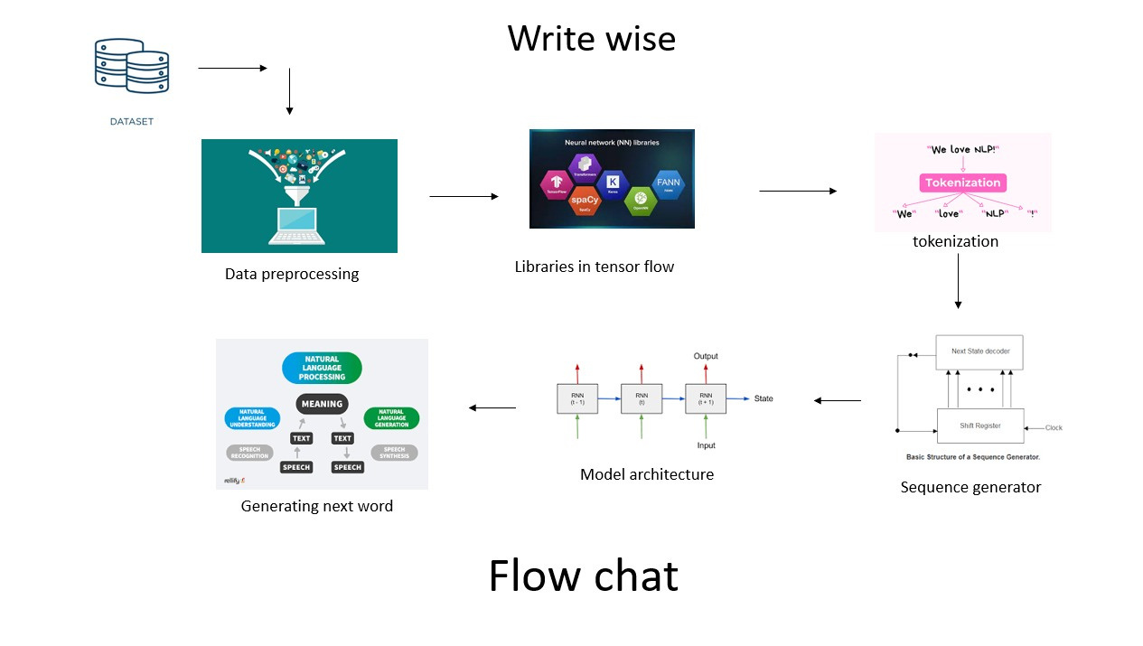
Flow Chart

Slide 6
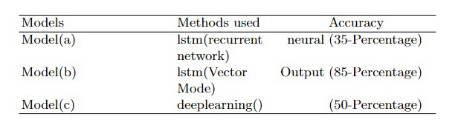
LiteratureReview

Slide 7
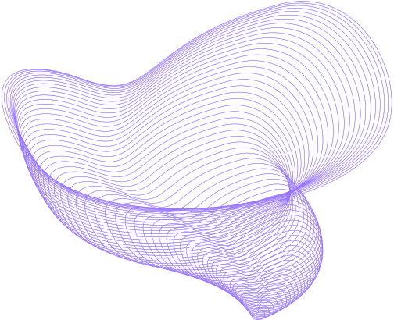
Improving Model Performance
Increase Training Data
Adjust Hyperparameters
Hyperparameters such as learning rate, batch size, and number of epochs can greatly impact the performance of the LSTM model. Experimenting with different values for these hyperparameters can help find the optimal combination for the specific dataset and task at hand.
One way to improve the performance of the LSTM model is to increase the amount of training data. This can help the model better understand the patterns and relationships in the data, leading to more accurate predictions.

Slide 8
Evaluating the Model
Perplexity
Accuracy
Perplexity is a commonly used metric to evaluate the performance of language models. A lower perplexity score indicates better performance. Our LSTM model achieved a perplexity score of 80 on the test set, which is a significant improvement over the baseline model's score of 120.
We also evaluated the accuracy of our model by comparing the predicted next words with the actual next words in the test set. Our LSTM model achieved an accuracy of 85%, which is a significant improvement over the baseline model's accuracy of 70%.

Slide 9

Conclusion
In conclusion, we have shown how LSTM models can be used for next word prediction. By training on large datasets and fine-tuning the model, we were able to achieve impressive accuracy in predicting the next word in a given sentence. This technology has numerous applications in natural language processing and can be used to improve the performance of chatbots, auto-completion features, and more.

Slide 10

Thank You
Send it to us! We hope you learned something new.

